Slide 1
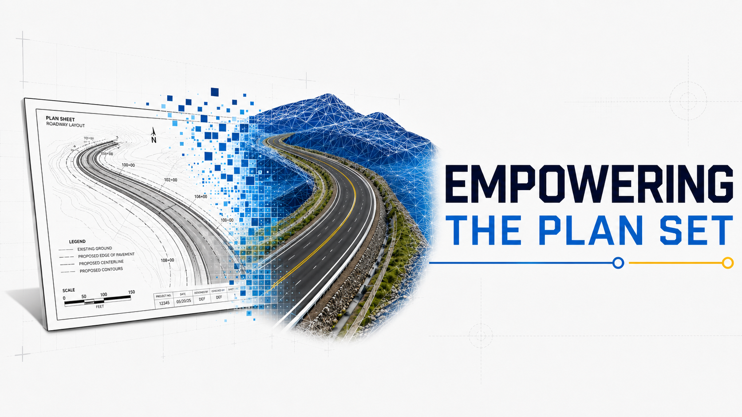

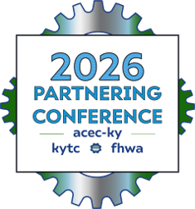
Models Matters
Cameron Brunty, PE
Blake Combs, PE
David Greenwell, PE

Slide 2




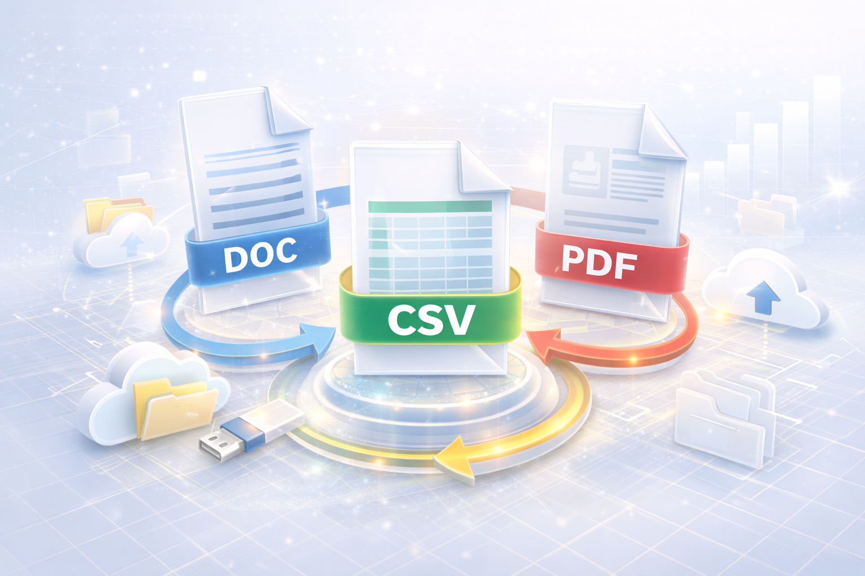
What is the goal of Deliverables?
ACCURATE
DATA
CONSISTENT DELIVERABLES
FILE
INTEROPERABILITY

Slide 3


This is why our deliverables need to be accurate, consistent, and useable.
CONSULTANT
PM And Design Staff
KYTC DESIGN
Limited To No Communication Between
KYTC CONST.
CONTRACTOR
RE And Inspectors
Project Communication

Slide 4

What are the deliverables now?
Sign and sealed plan sets. (Legal contract document)
Electronic Engineering Data
Estimates
ENOI and Final Drainage Folder
Project Records
Various Excel Sheets
Project Specific Details
To Contractor
Kept In House

Slide 5
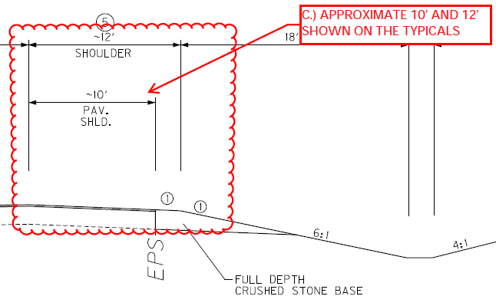
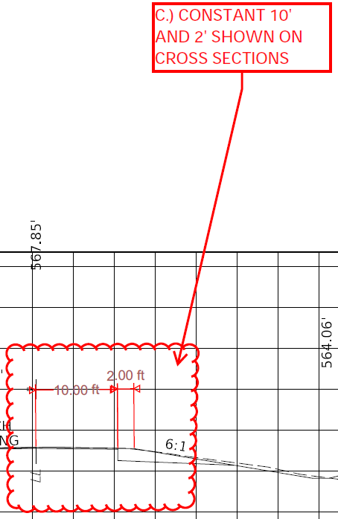
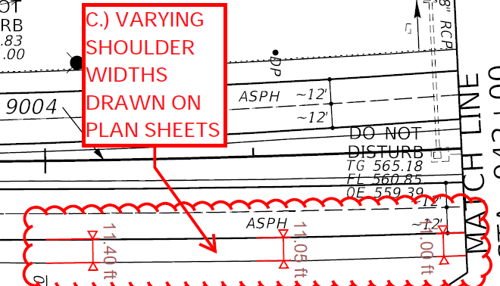
Request For Information - Dimensions

Slide 6
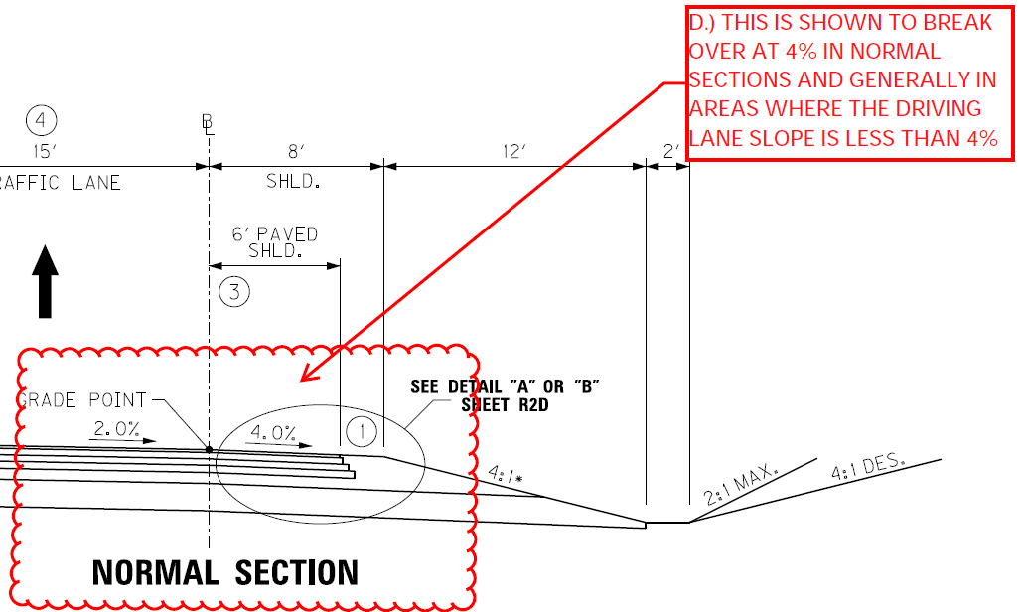
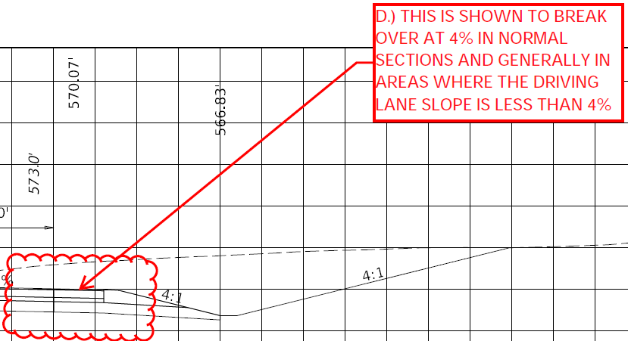
Request For Information - Slopes

Slide 7
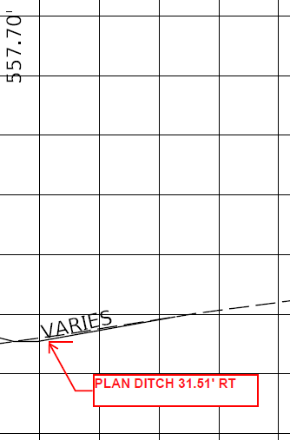
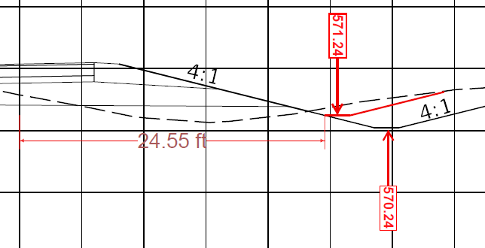
Request For Information - Ditches

Slide 8
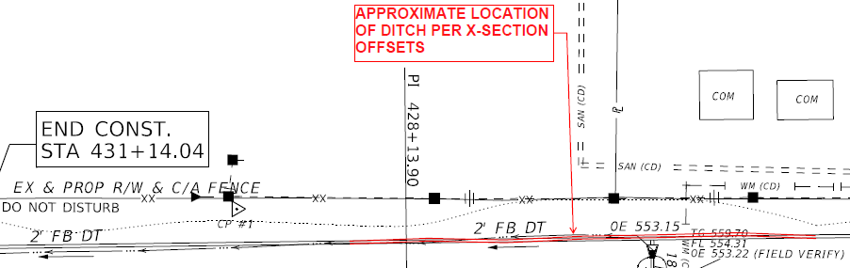
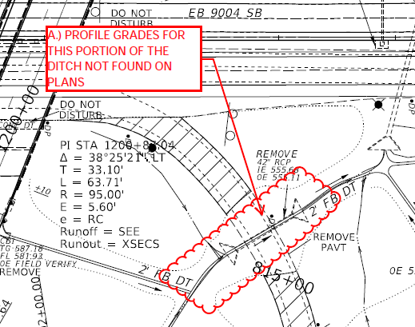
Request For Information - Ditches

Slide 9
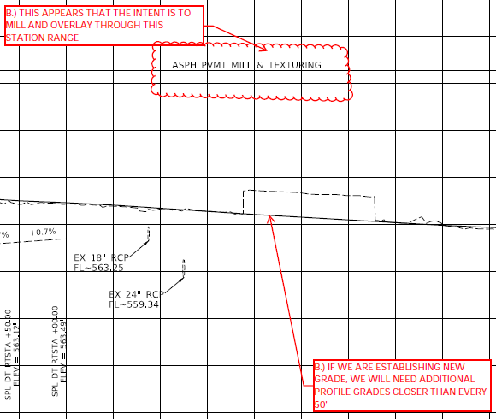
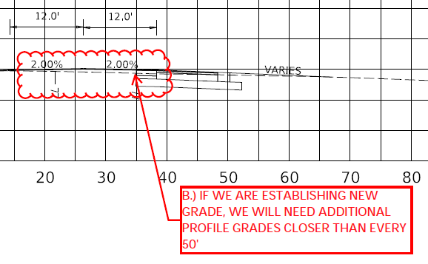
Request For Information - Grade

Slide 10
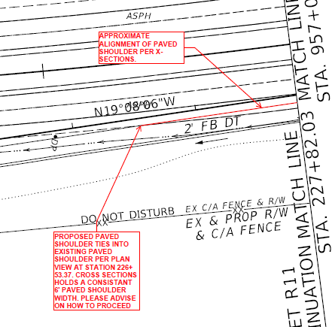
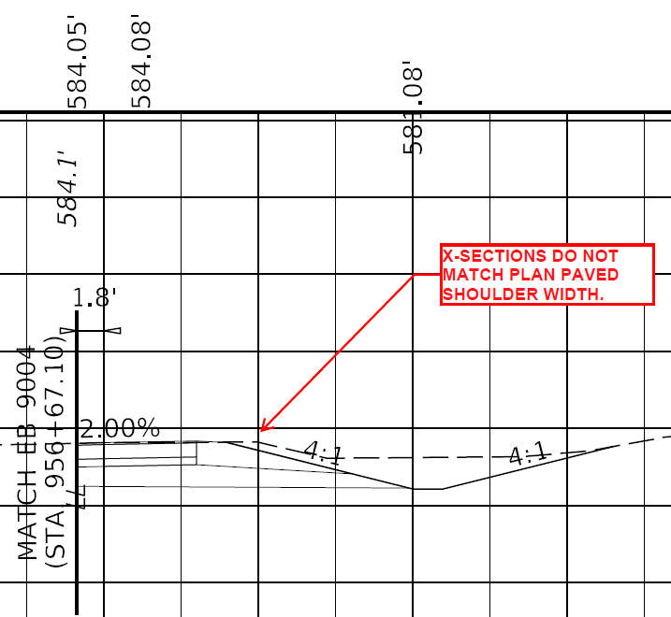
Request For Information - Pavement

Slide 11
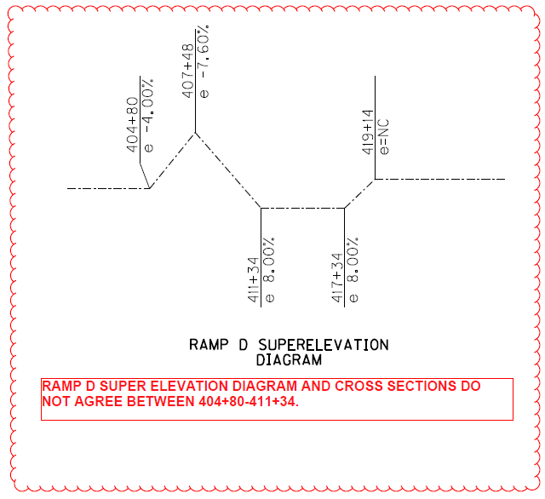
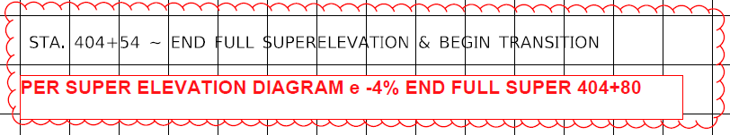
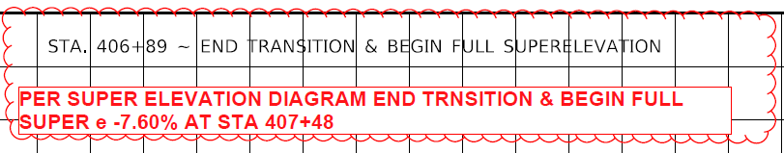
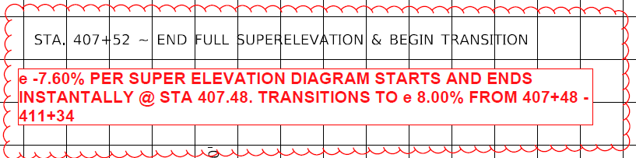
Request For Information - Superelevation

Slide 12
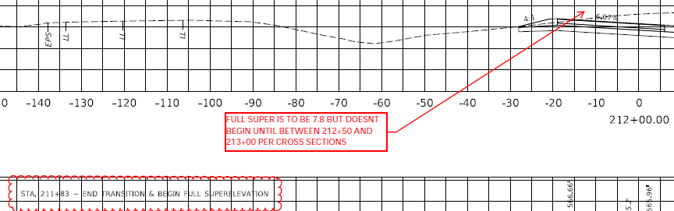
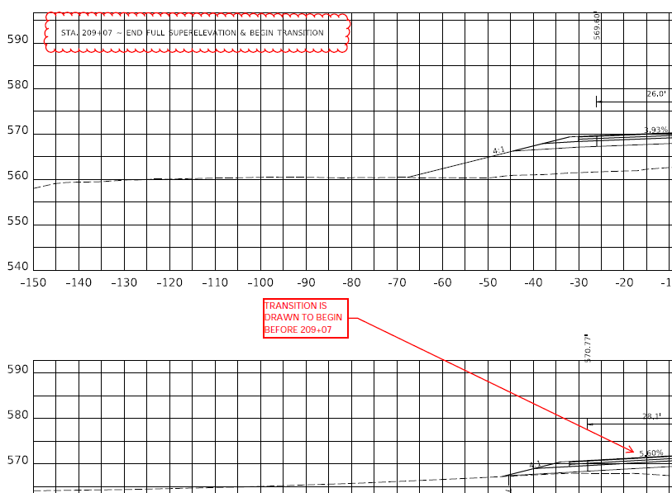
Request For Information – Superelevation

Slide 13

The Intent of The “EED”
Provides clarity when plans are confusing or contradictory.
Relays information which can be difficult graphically.
Delivers context and additional design intent to the plan set.
Provides inspectors 3D data to verify construction work in the field.

Slide 14

The Cost Of Confusion
Time and money for everyone involved.
  Increased bid prices.
  Design team having to stop current tasks and address questions.
  Completion and MOT schedule delays.
Potential quality of final product.

Slide 15
Let’s Review A Model As A Group
Notes:
Hey I’m Dave Greenwell with the Central Office Developmental Branch. Today I’ll be going over Roadway Models and the model review process. If you haven’t already, you can scan the QR code to take you to the Mentimeter. We have a group activity. As a room, we will review a model together. Lets take a look at this model and afterward we will review it as a room.

Slide 16

Let’s Review A Model As A Group

Slide 17
Let’s Review A Model As A Group
Notes:
Hey I’m Dave Greenwell with the Central Office Developmental Branch. Today I’ll be going over Roadway Models and the model review process. If you haven’t already, you can scan the QR code to take you to the Mentimeter. We have a group activity. As a room, we will review a model together. Lets take a look at this model and afterward we will review it as a room.

Slide 18
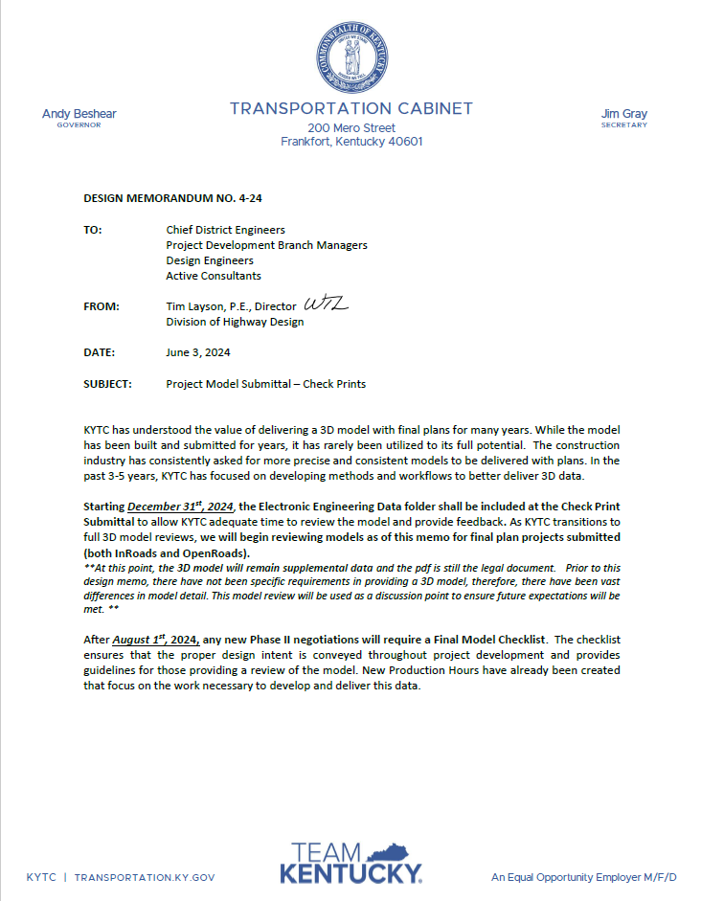
Design Memo 04-24
Electronic Engineering Data (EED) shall be included at Check Print Submittal.
At this point, information in the EED is supplemental data.
The PDF plan set is the record legal document.
Model reviews are based on Check Print Submittal data.
Reviews are performed by CO Developmental Branch or District PM.
Notes:
We’ll start with Design Memo 04-24.
At the beginning of 2025 all Check Print submittals shall include the Electronic Engineering Data Folder.
The key word on this slide is supplemental. The 3D model is still supplemental
PDF plans are currently and will continue to be the legal document
So, who is handling the model review. It is currently handled by Central Office Developmental Branch

Slide 19
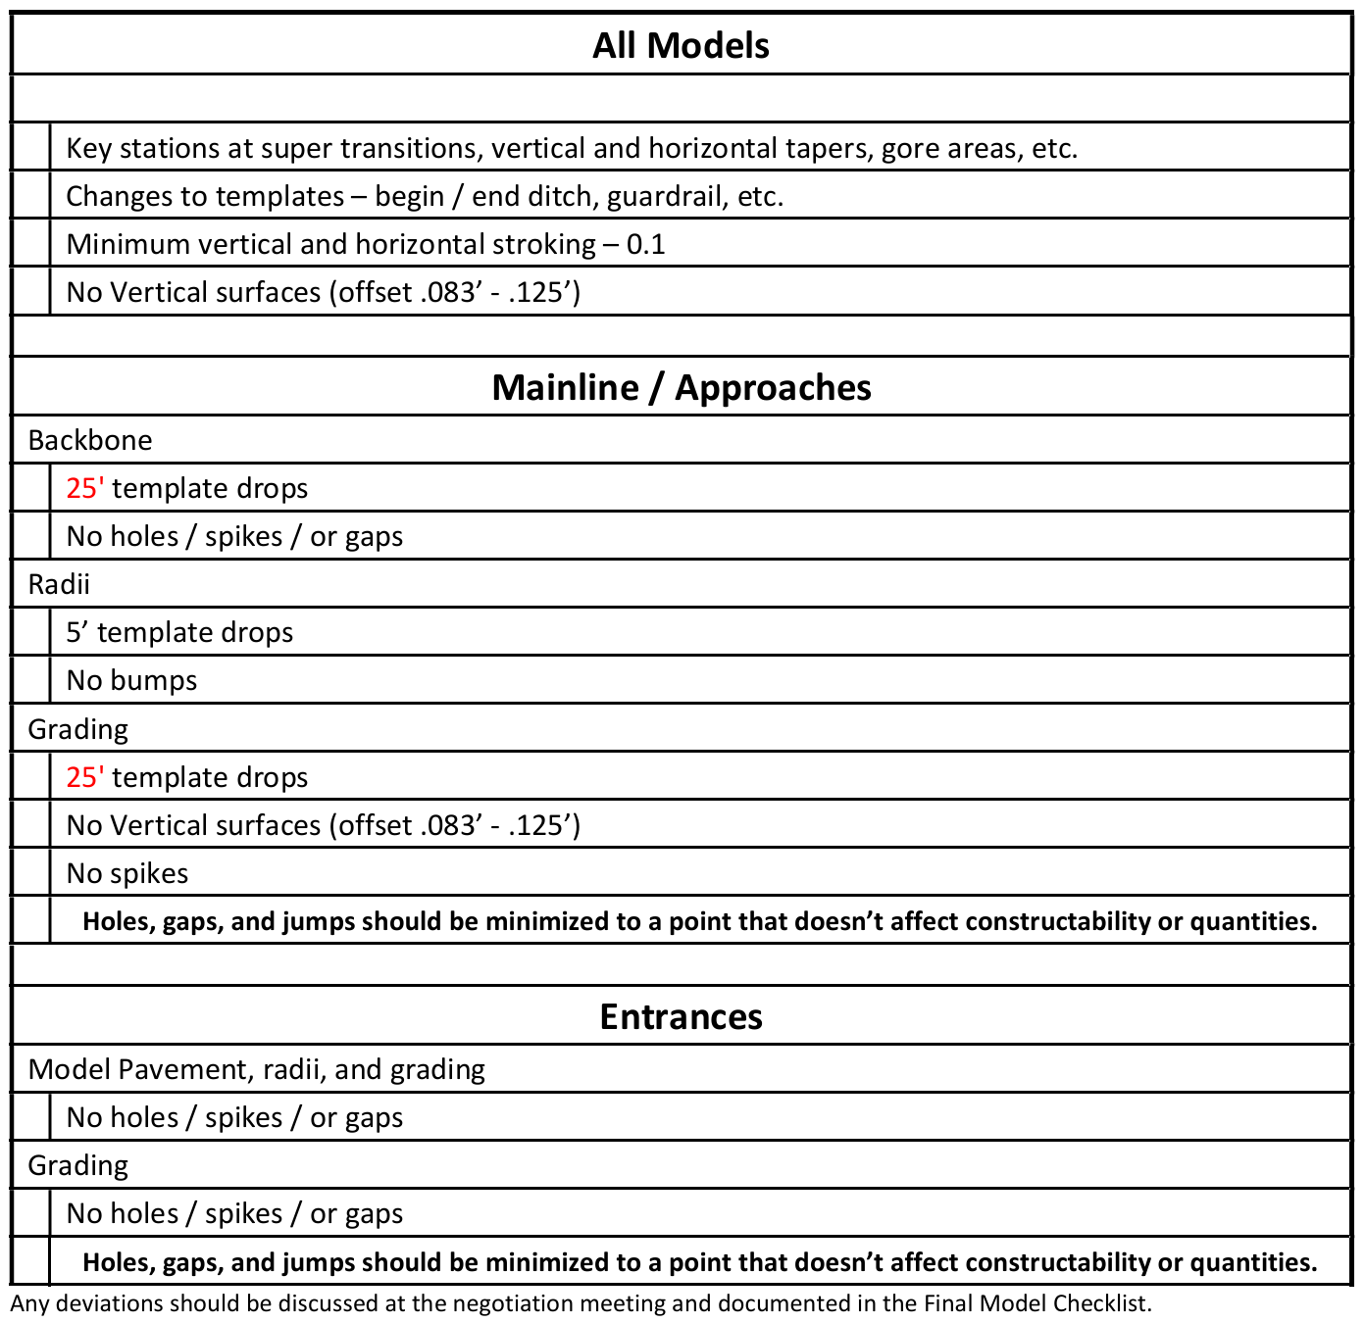
Design Memo 04-24
There is a minimum standard for EED ORD model information established in DM 04-24.
Expected template drops are defined.
No holes /spikes /or gaps.
Key stations at transitions, tapers, gores, etc.
Notes:
Looking further at the memo, we establish some minimum expectations for the ORD information that we're receiving. Here we're looking at expected template drops, making sure we don't have holes, spikes, or gaps.

Slide 20

KYTC Model Reviews - Purpose
Deliver better 3D data to downstream users.
Hold designers accountable.
Establish future expectations for detail and consistency.
Key step in the path of digital delivery/model-based design.
Notes:
The purpose of these model reviews is to deliver better 3D data to our downstream users.
The construction industry has consistently asked for more precise and consistent models to be delivered with plans.
We want to hold designers accountable – if were paying them, if it’s built into their contract hours - they need to be held accountable.
Model reviews will help establish future expectations as we head toward delivering better 3D models.

Slide 21

What Projects Apply?
Projects developed using OpenRoads Designer after Design Memo 04-24.
InRoads projects not currently reviewed.
Certain specialized programs using ORD are not being reviewed. E.g. Pavement Rehabilitation.
Notes:
The review process does have some limitations. We're primarily looking at projects developed in ORD after Design Memo 04-24. InRoads projects aren't currently being reviewed. And there are also some specialized projects using ORD that aren't part of the review process, such as pavement rehab projects.

Slide 22
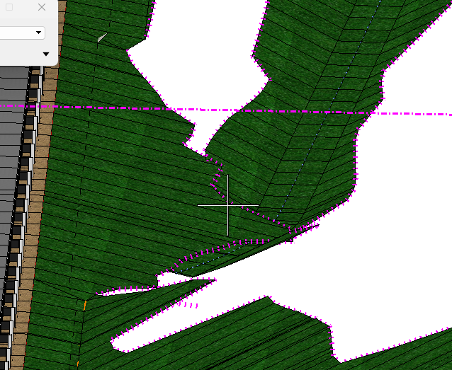
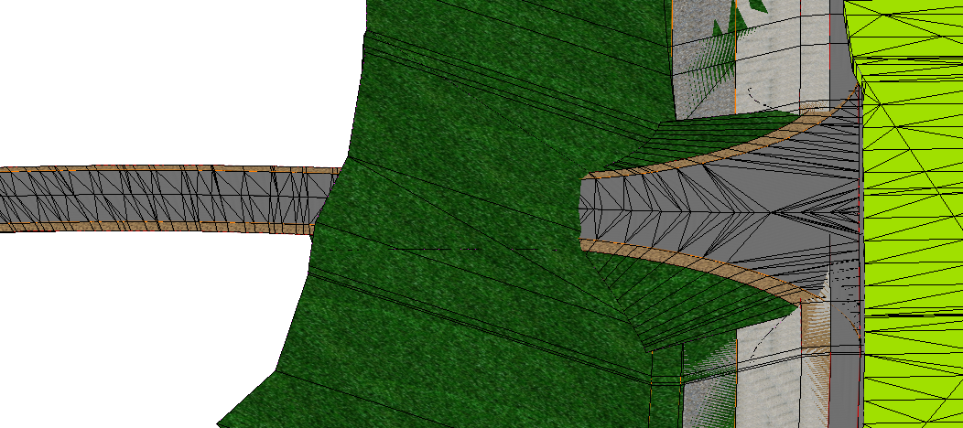
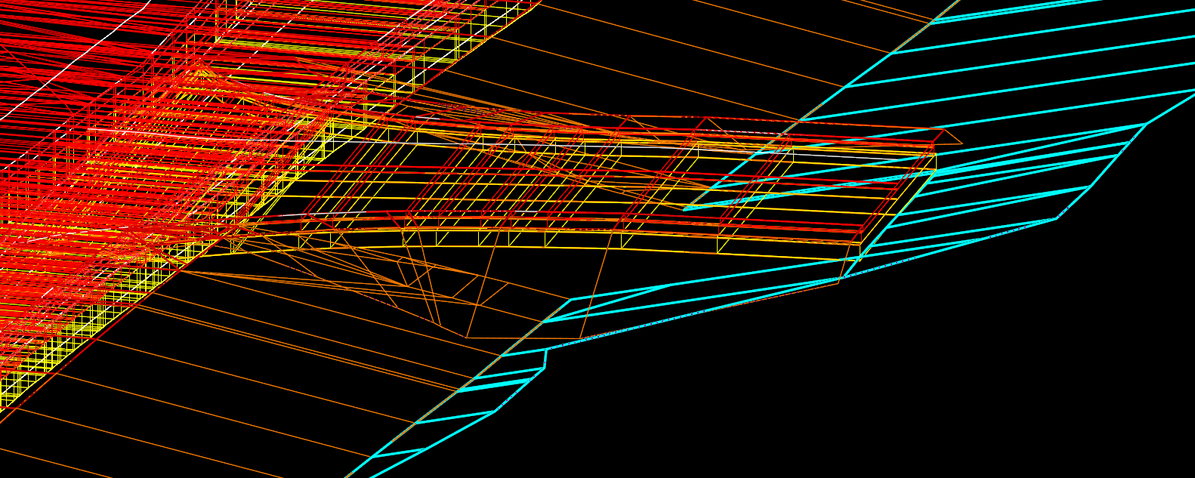
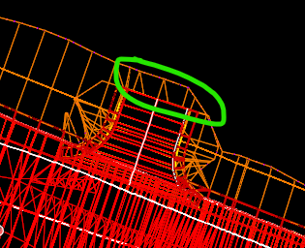
What Are We Looking For With Reviews?
Overlapping Breaklines
Notes:
Anything that makes the model unusable for contractors and inspectors
Overlapping Break Lines
Lines cross through lines and create mismatched elevations.

Slide 23
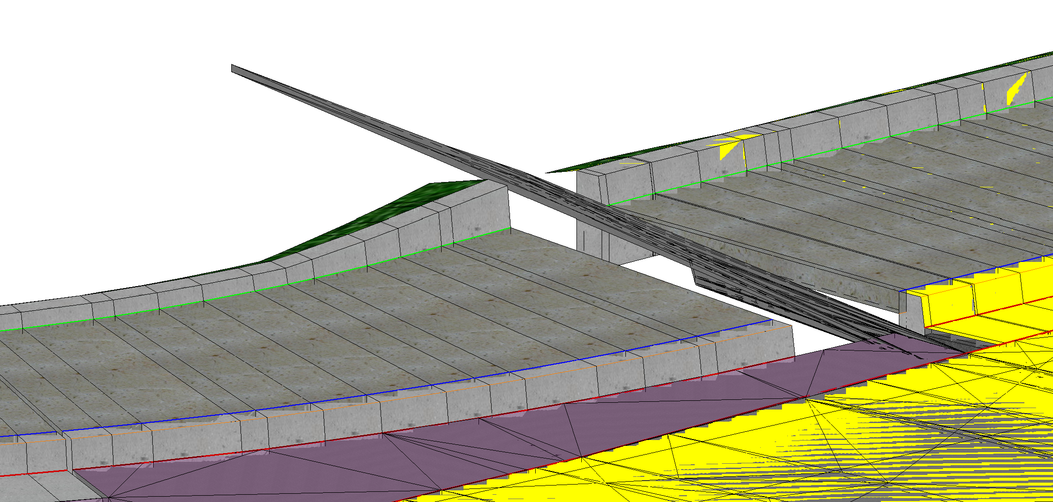
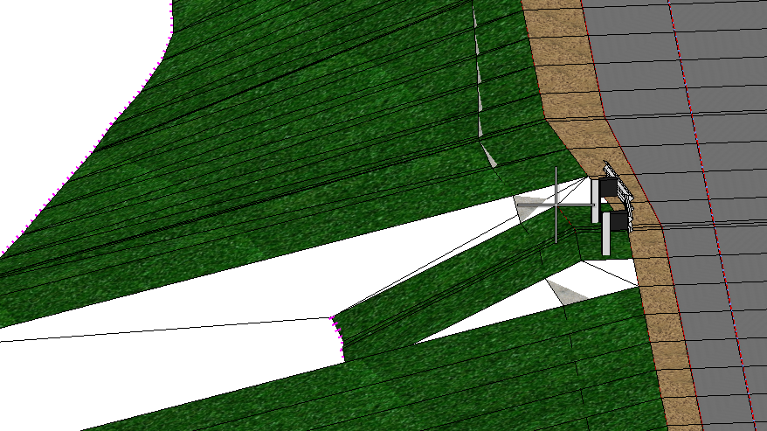
What Are We Looking For With Reviews?
Backbone: Holes/Spikes/Gaps.
Grading: Holes/Spikes/Gaps that affect constructability or quantities.

Slide 24
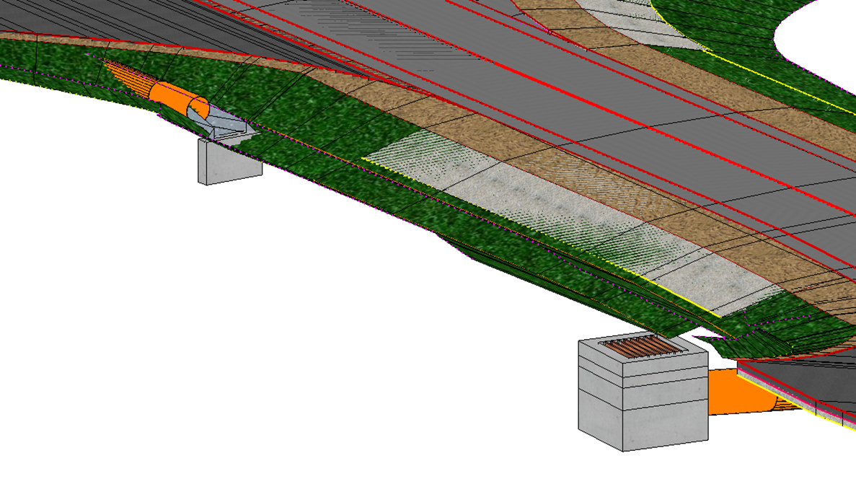
What Are We Looking For With Reviews?
3D Drainage Models
Notes:
3D Drainage is important.
After meeting with companies like Scotties and SiteTech who build the models for contractors - having 3D drainage modeled is important for construction modeling.
When I say 3d drainage model, I mean the physical layout and geometry used for design and construction—not the hydraulic analysis

Slide 25

Additional Review Items
Accuracy of model data to plan set and cross sections.
Modeled vs Hand Drawn
Disturb limits matching models limits.
Do the appropriate elements connect
Notes:
We're also comparing the model against the plan set. The plan set is still the legal document, so we're not using the model to redefine the design. Instead, we're asking whether the model represents what's shown in the plans and cross sections.

Slide 26
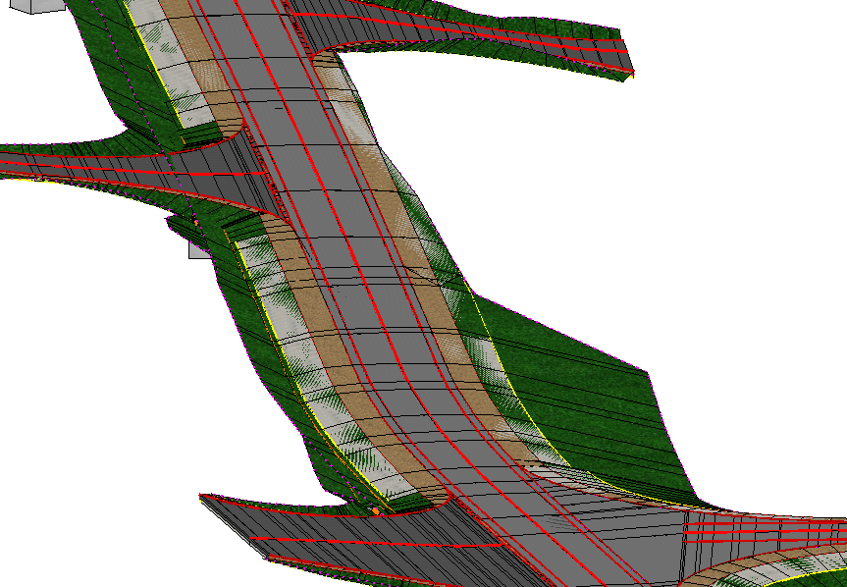
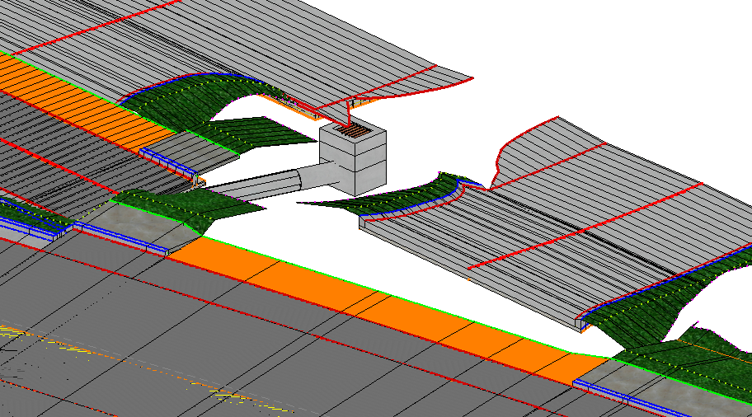
The Good, The Bad, The Ugly
There is no consistency in what is being submitted today.
Notes:
The good the bad and the ugly. The men from the video earlier. I’ll let you decide who is which.
There is currently a pretty wide range in what we're receiving. We've seen some really good models. We've also seen models where it's difficult to determine what we're actually supposed to be looking at. And that's not necessarily because somebody did something wrong. Sometimes it's simply because there hasn't historically been a consistent expectation for what the final model should look like. That's what we're trying to change

Slide 27
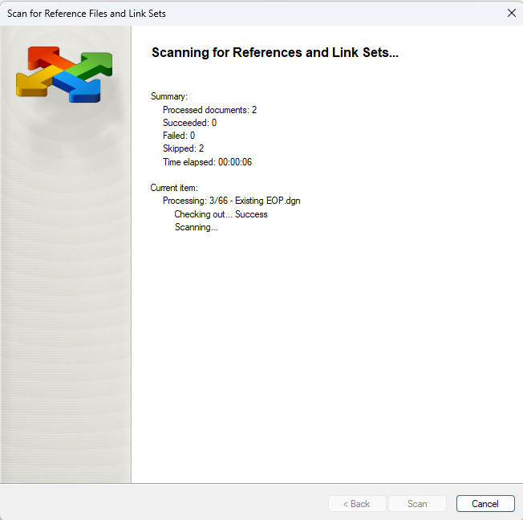
Struggles and Limitations
Inconsistent data being submitted: Naming, Structure, Subfolders, etc.
Consultant projects – references are broken.
  Rescan for references
  Search to find the files we need.
Notes:
One of the biggest problems isn't even the model itself. It's finding the information we need. One limitation of OpenRoads’ reference-based workflow is that file links can break when projects are transferred. Transferring the projects from a consultant to a KYTC PM and then either to ProjectWise or to Central Office before being copied and scanned within projectwise. On a small project this may take 30-45 minutes. For larger jobs this can take hours. All of that takes time before we've even started reviewing the model.

Slide 28
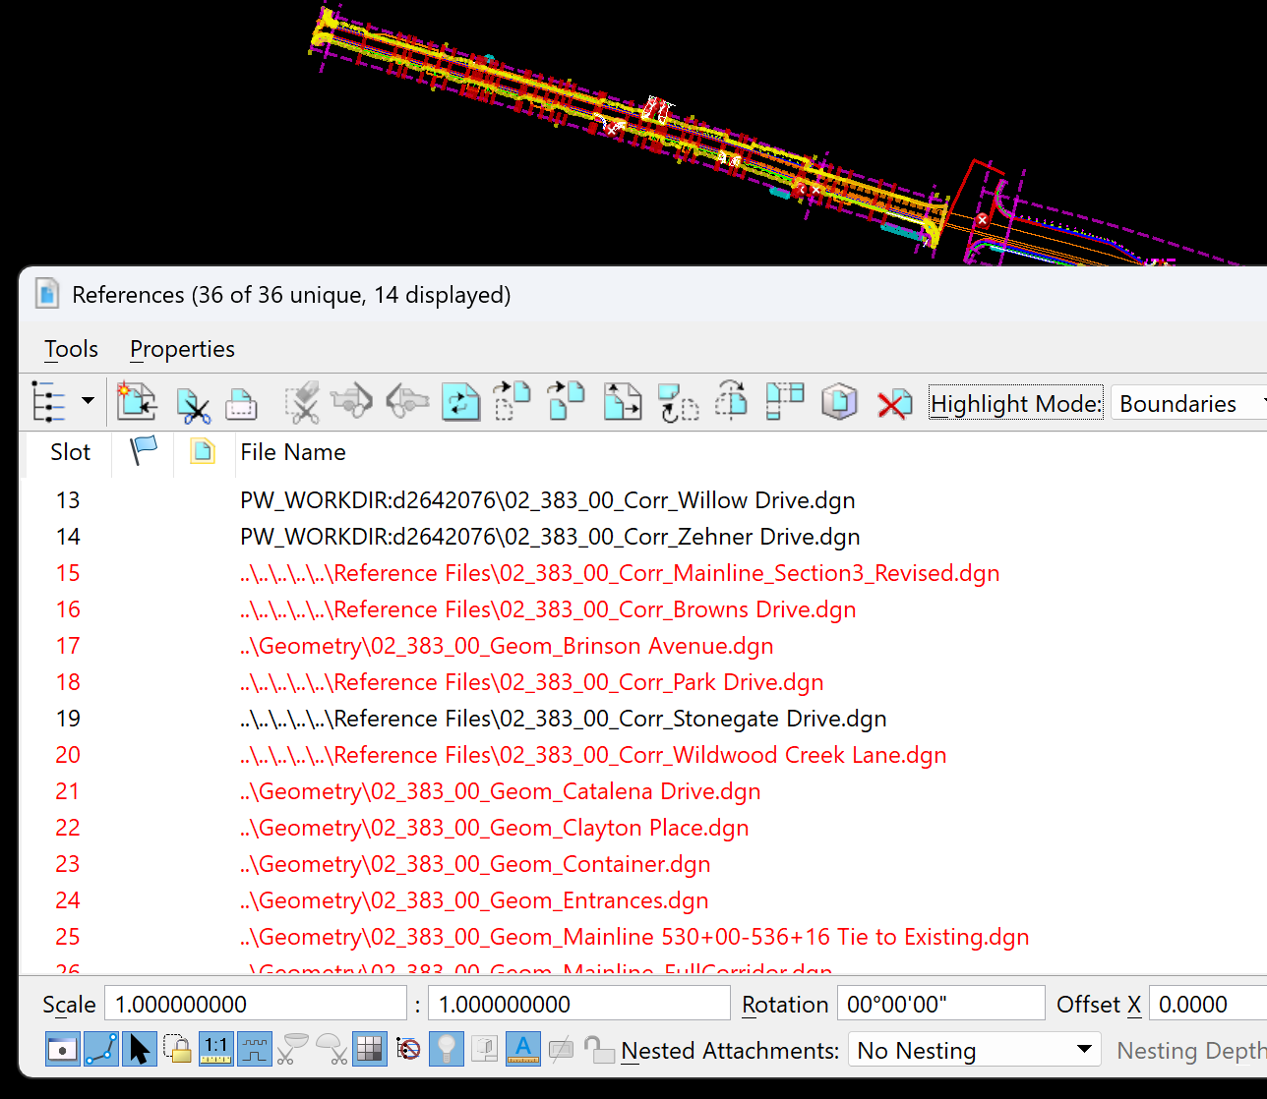
Struggles and Limitations
Reviewers often are having to reconstruct the model.
Substantial amount of work for project managers and reviews before you open the first file.
Notes:
We're taking the files that were submitted and trying to figure out what the designer intended, what references are needed, if drainage files were modeled and included, and how everything fits together. At the end of the day, we're not asking designers to model something just because it looks good, we're asking them to provide information that somebody else can actually use downstream. So, I will had it off to Blake to give us his perspective on why models are important for Project Managers.

Slide 29

Why Models Are Important to PMs
Provides context during plan reviews.
Improves consistency across the plan set.
Reduces construction delays due to design issues and questions.
Reduces change orders with more accurate quantities.

Slide 30
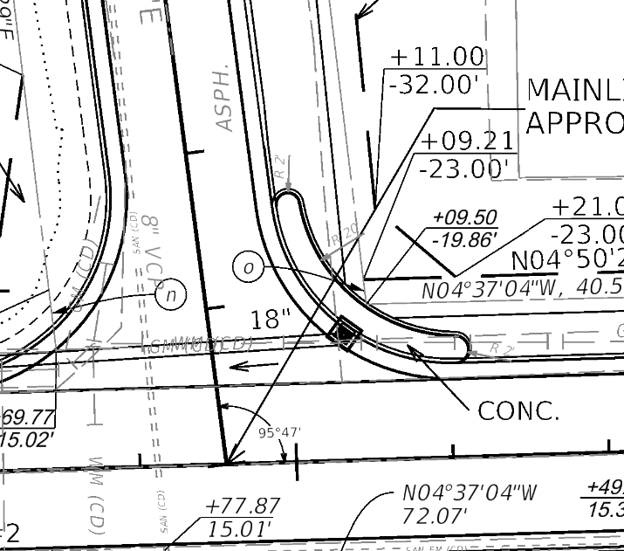
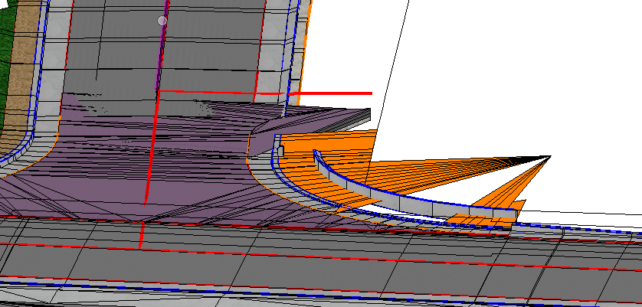
Things To Look For In The Model
Notes:
One of the things I check for in model reviews is that the deliverables are in agreement with one another.
If plans , cross sections, and model do not match there is a high likelihood that the design intent will not be conveyed as desired.
These discrepancies can lead to RFIs which can delay the project.

Slide 31
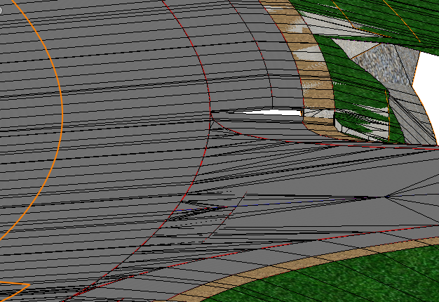
Things To Look For In The Model
Backbone and grading not transitioned from approach to mainline.
Notes:
Another item I believe is important to review in the model is transitions between different corridors.
In this example you can see that the approach was not transitioned to match the mainline accurately.
This could leave the contractor with questions on what the intent was here and could potentially cause it to be constructed incorrectly.

Slide 32
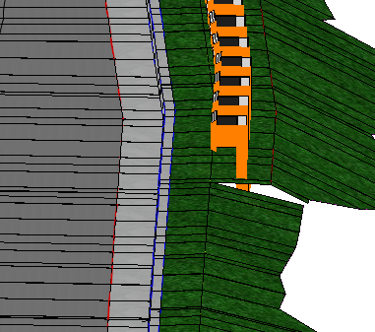
Things To Look For In Model Reviews
Grading for end treatment not modeled.
Notes:
In this example the grading for the guardrail end treatment was not modeled.
This is a common item that is not modeled and has caused construction issues in the past.
It is important to model these type of items so that they can be constructed according to the applicable standards, adequate right of way can be acquired, and utilities can be relocated to the proper location.

Slide 33
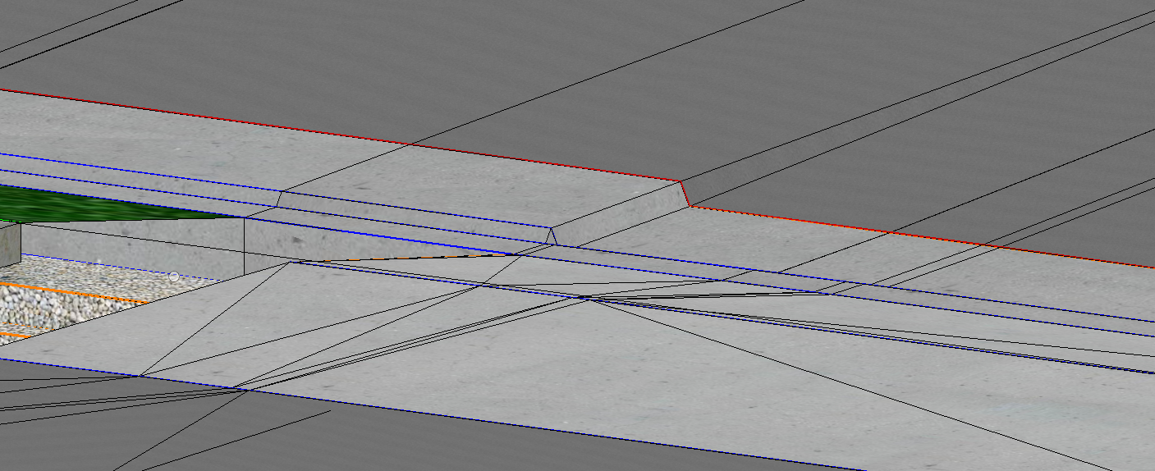
Things To Look For In The Model
When entrance was tied in it warped the cross slope and dropped curb below gutter.
Notes:
Reviewing the model can help to identify potential issues that may not be obvious on the plans.
In this example you can see that when this entrance was tied in it created several issues with the backbone.
If the model had not been reviewed this likely would not have been noticed until it made it to construction.

Slide 34
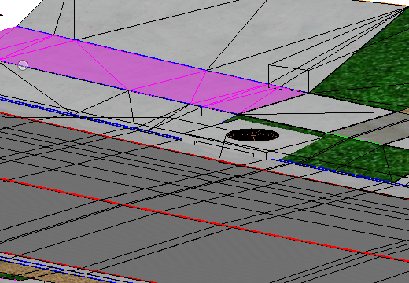
Things To Look For In The Model
Curb box in an area where all curb is ramped down for entrances.
Notes:
Model review also helps with ensuring that drainage structures are placed in the proper locations and are constructable.
In this example you can see that there is no curb available for the box to be tied into due to being near multiple entrances.
After the model review the designer was able to select a different drainage structure that would work in these conditions.

Slide 35
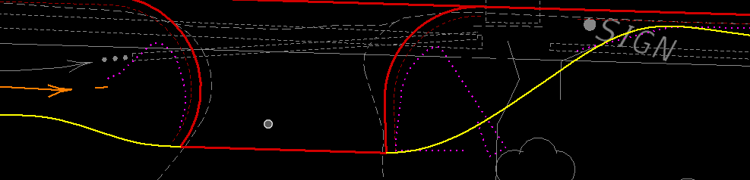
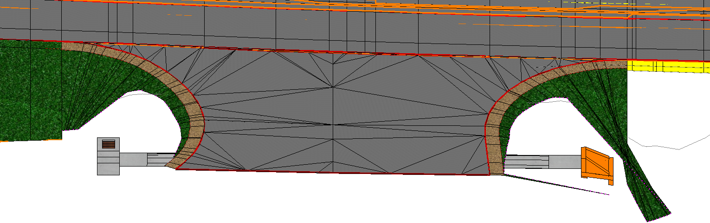
Things To Look For In The Model
Disturb limits hand drawn and not modeled to accommodate drainage.
Notes:
Model reviews also allow us to see if any items are hand drawn and if those items may cause issues.
In this example the yellow line is the disturb limit copied from the base file so that it can be compared to the disturb limit in the corridor.
As you can see there is a quite a bit of difference between the two. When reviewed in 3D it appears the grading was not designed in a way that would accommodate the proposed drainage.

Slide 36

Lessons Learned: EEDs Not The Answer
Can contain 100s of design files. File structures and naming convention varies designer to designer.
Require Bentley licensure to interact with.
Interfile connectivity (e.g., references) breaks when moved.
No relinkage process outside of project wise.
Requires ORD expertise to navigate.

Slide 37


Where are we going then?
Come to the next presentation and find out.
Empowering the Plan Set - CADD Policy
Thank you for your time today!

Slide 38

Questions?

